Slide 1

E-Market Place for TRIBES in INDIA for selling their DÉCOR.
Team Name : ARM
Team Members : Vikas Kumar
Aman Chauhan
Sangam Verma
Rohit Prajapati [Leader]

Slide 2

Some Statistics About TRIBES : ( DATA OF TARGETED AUDIENCE )
Problem :
Reaching out all those tribal people who are very skilled and wants to spread their business.
Providing an independent source of income
Trying to bring out some faces out in the front and setting an example to all the tribes that they are nothing less.
Solution :
A web – app specially designed for tribal people to sell their handmade crafts , decors etc. directly to public.
The only intermediate will be the government.
To do so, special teams can be formed to personally approach in rural areas , Various camps can be organized…...
State | Population of Tribes | B.P.L Percentage
Odisha | 8.1 million | 46.8 %
Madhya Pradesh | 4.3 million | 36.9 %
Maharashtra | 10.6 million | 29.6%
Rajasthan | 7.09 million | 18.7%
Chhattisgarh | 6.61 million | 7.50%

Slide 3
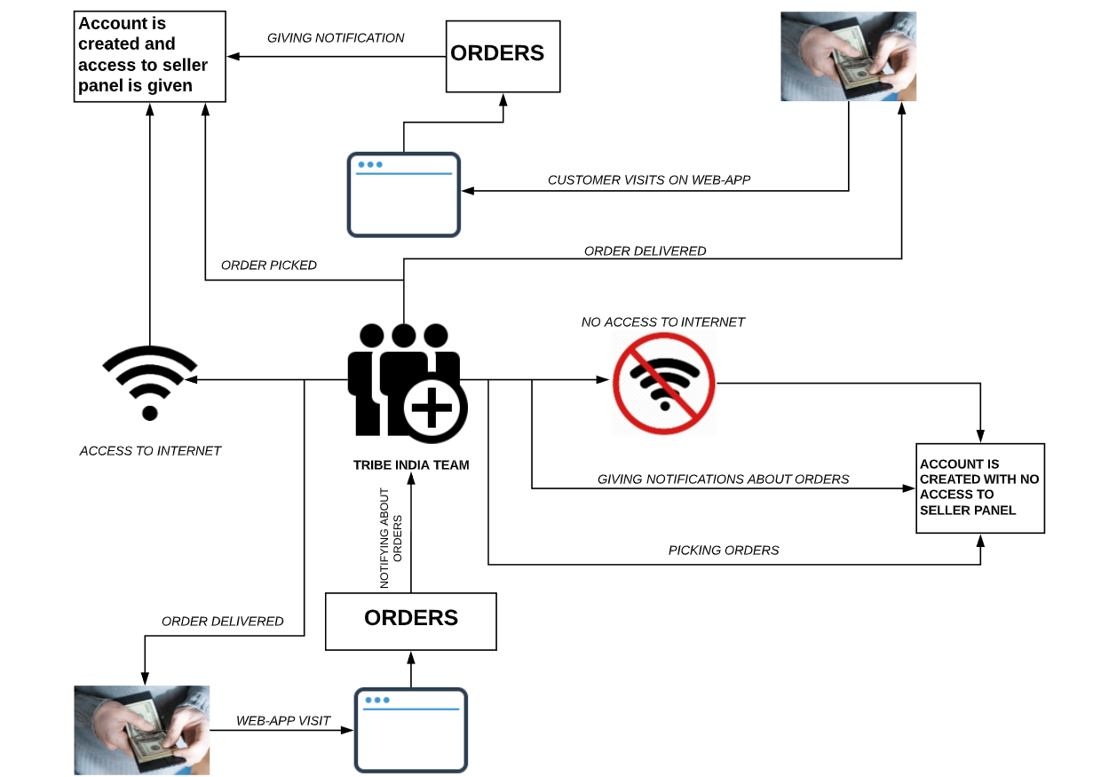



Slide 4
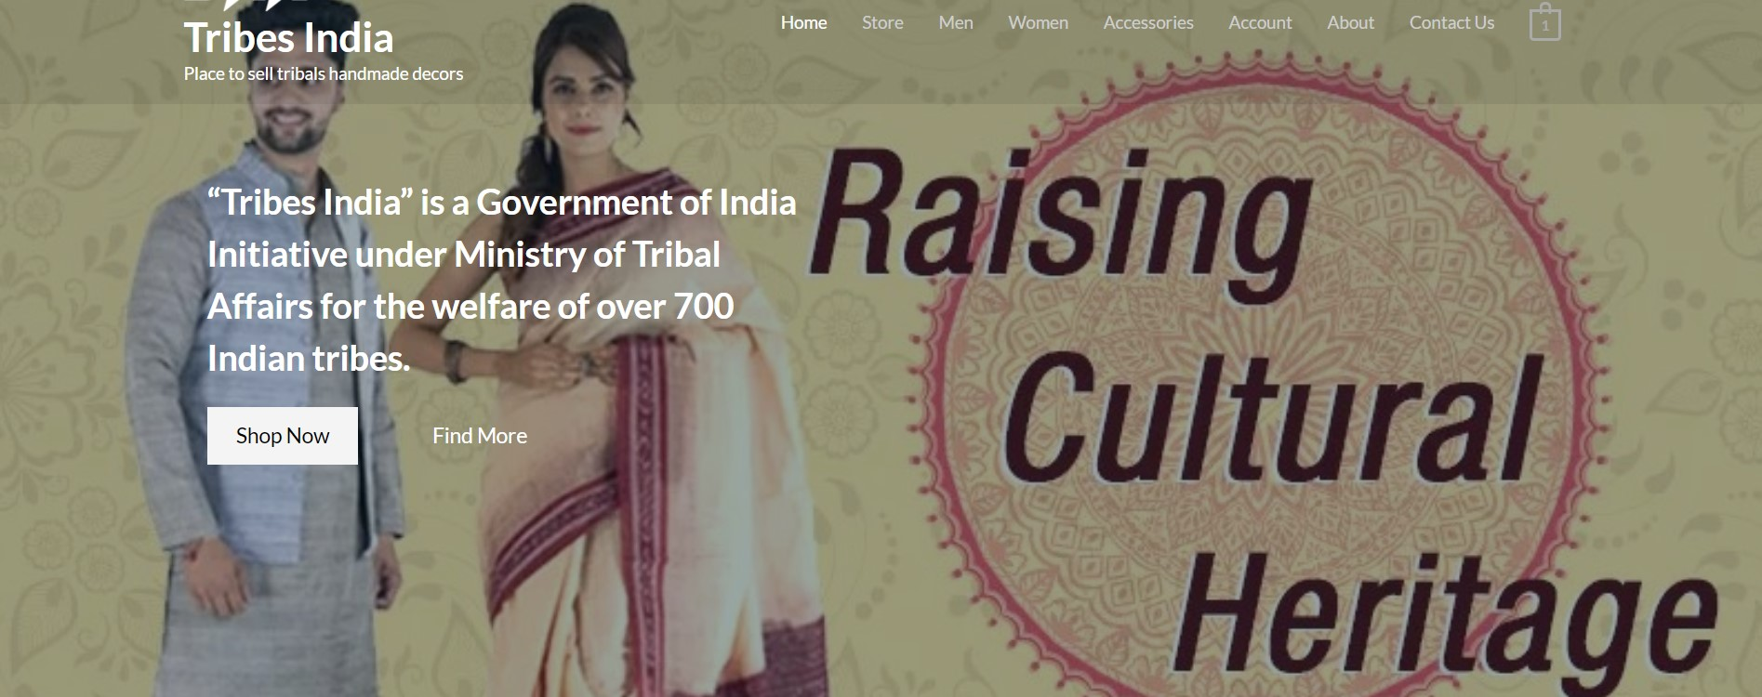
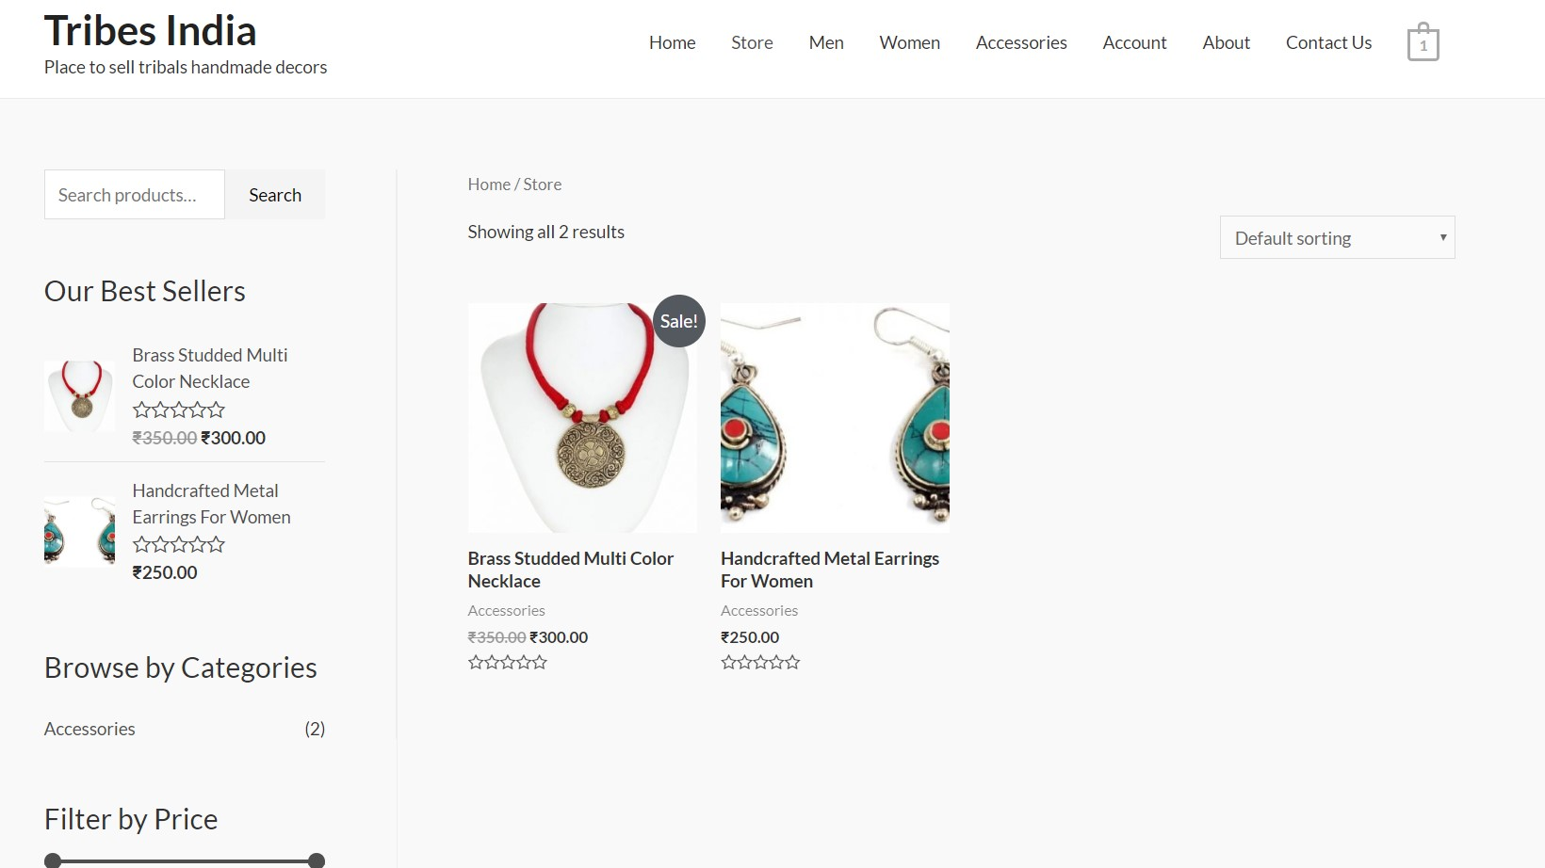
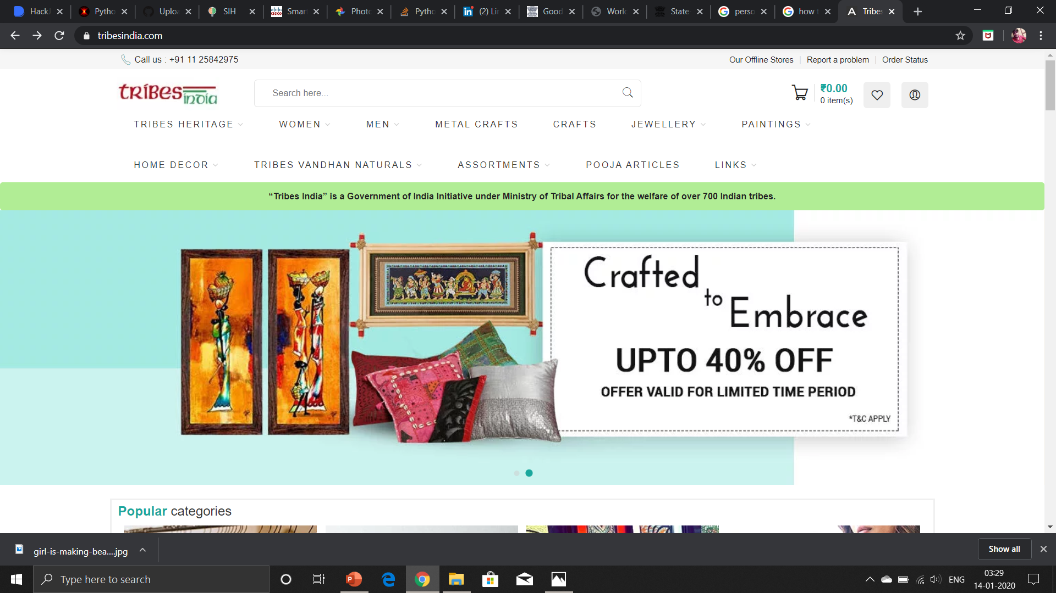
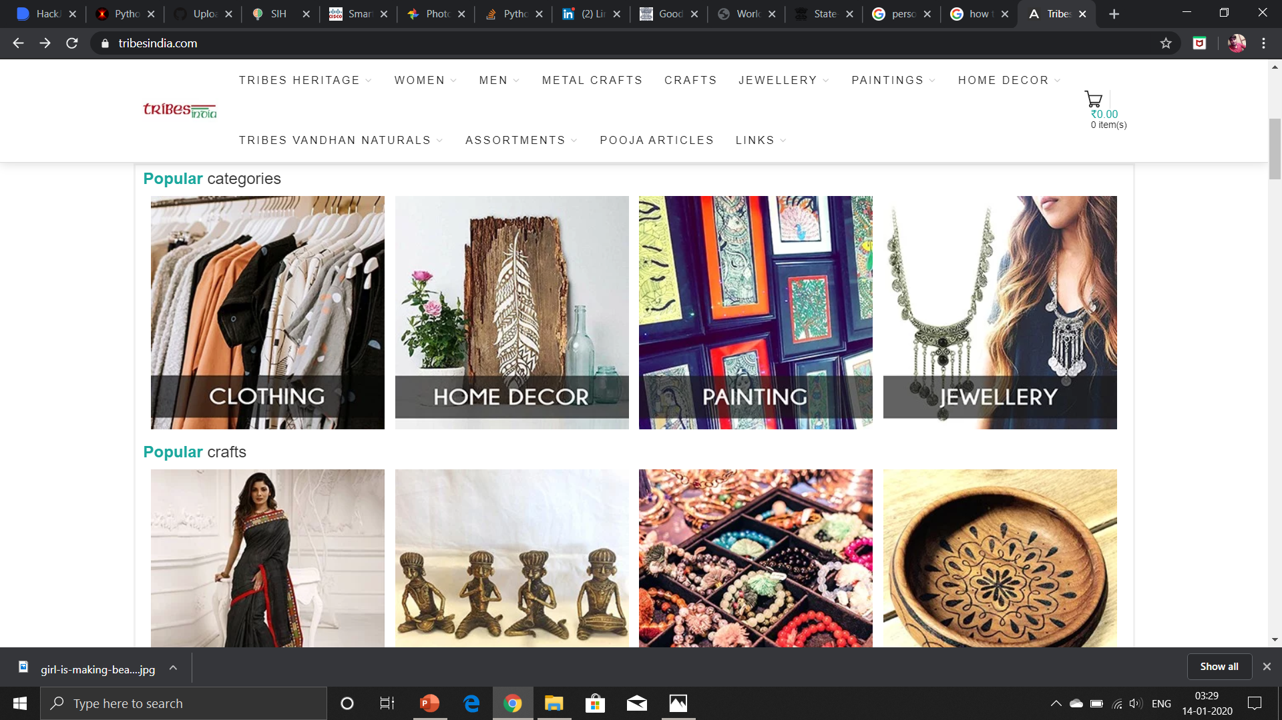
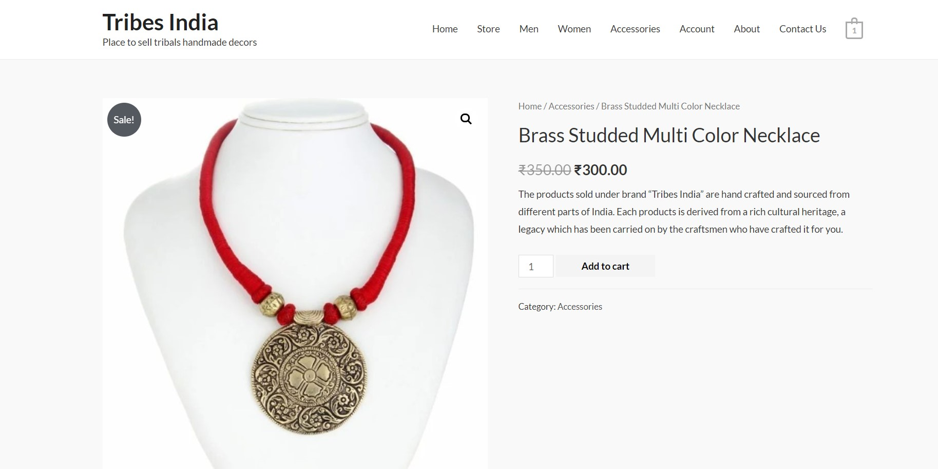
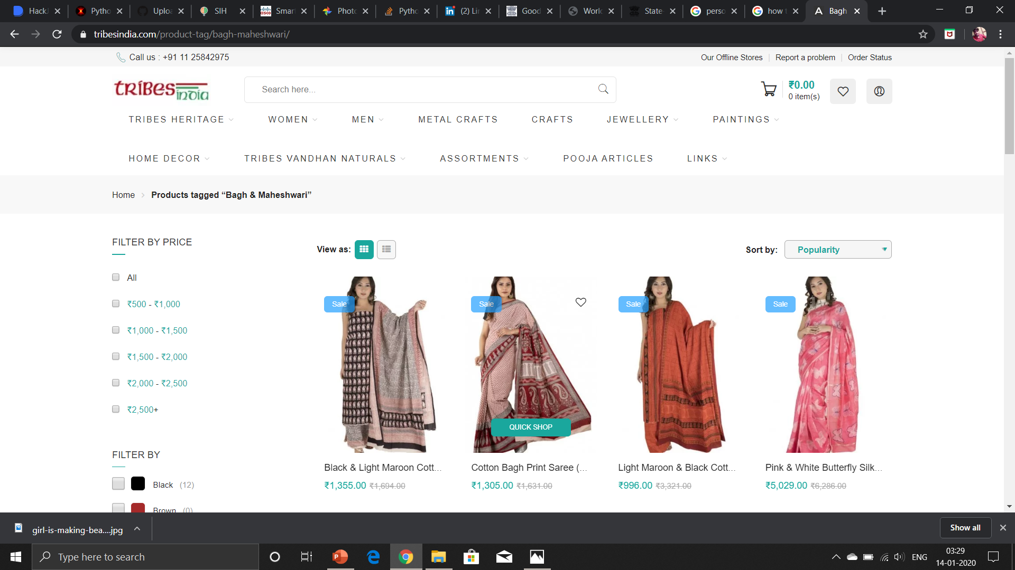
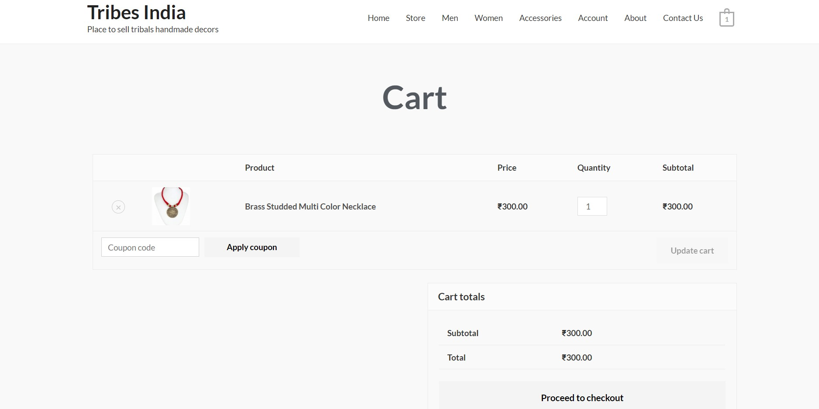
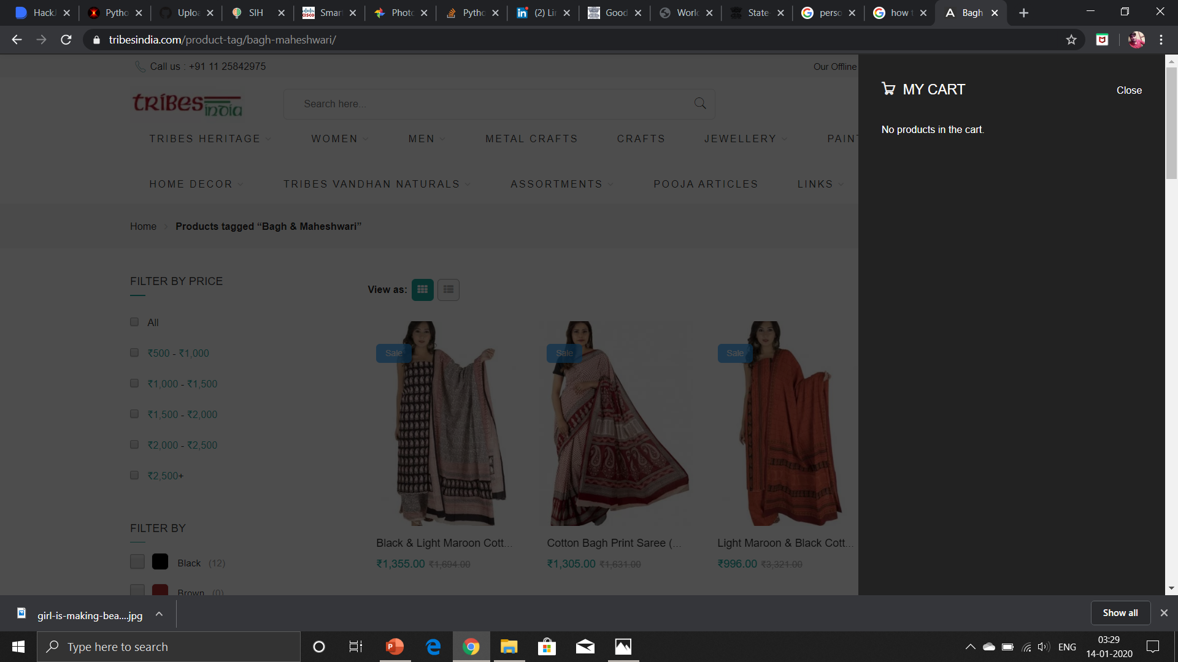
OUR WEB-APP :

Slide 5
Thank you !!

